Slide 1
Dive into the world of machine learning!
Annica Ivert
aniv@netlight.com

Slide 2
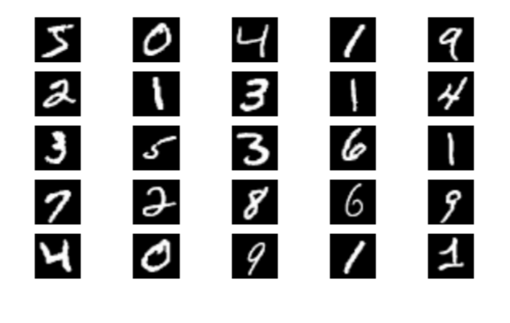

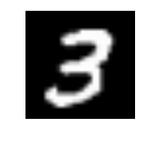
Case: Handwritten digit recognition
3
Goal: Train a ML model that can classify a 28x28 pixel image of a digit.
Find some function that takes 784 input pixels and transforms it to the correct output response

Slide 3
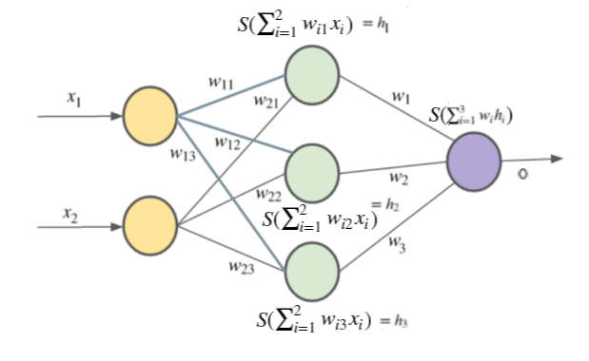
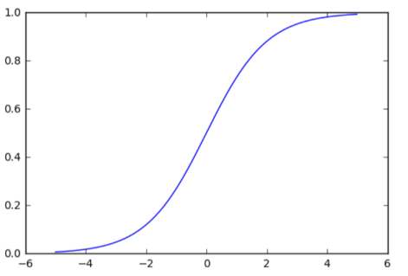
Artificial neural networks
The ML model we will use is called an ANN and is inspired by our brains
It basically represents a function that takes some inputs (an image) and produces some output (the label)
Between the input and the output there exist a number of “hidden layers”
When calculating the output, the input is multiplied with the weights and passed through an activation function
(in our brains neurons either “fire” or do not)
Our goal is to find the optimal set of weights

Slide 4

ANN - digit recognition
One-hot encoding of the number 3
Flatten 28x28 image to 782x1 array

Slide 5




How do we train the model?
Minimize cost function
Differentiate!
Initialize model with some random weights
Calculate output response for some training data.
Our data will be tuples :
This is a supervised learning problem, i.e. we know what the response should be for each data sample.
We want to update the weights of the model in such a way that the error decreases.
The error is a function of the input, weights and output.
The only thing we can change are the weights.
How do we find min/max of a function? Differentiate the error function with respect to weights!
Update weights in the direction where the error decreases (gradient descent).
( , )
Correct response
Output from model
W
W
1
2
error for one data sample

Slide 6
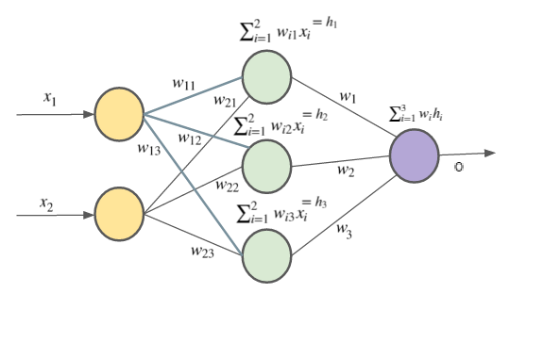
Gradient descent
We want to minimize the cost function, i.e. the error of our predictions
If we calculate the derivative of the cost function with respect to the weights, we know in which direction to update them in order to decrease the error
If we do this repeatedly the hope is that we find a global minimum
If we update the weights to little in each time step we might get stuck in a local minima
If we update them to much, we might not converge
We stop updating the weights after a number of epochs or when the gradient is smaller than some threshold
gradient
cost (error)
w
i
function of input, weights

Slide 7
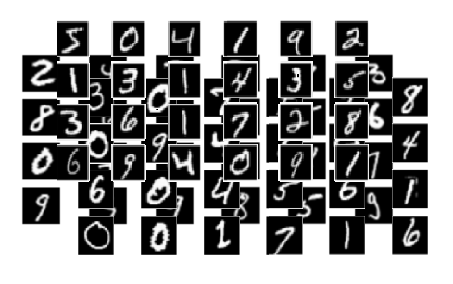
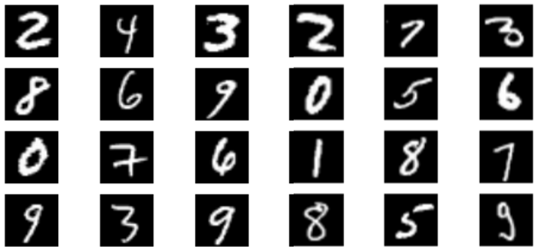
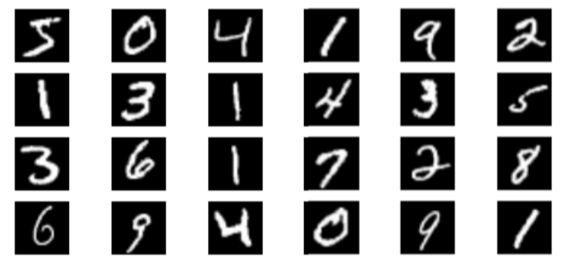
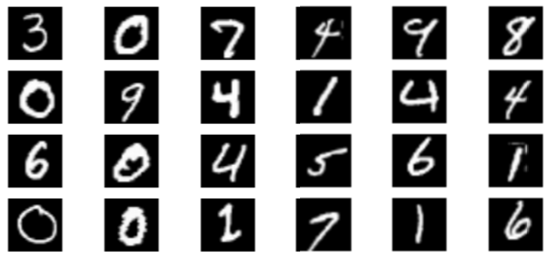
Training and validating a ML model
TEST DATA
TRAINING DATA
Used to evaluate the final model
Used to update the weights, and optimize a single ANN
VALIDATION DATA
Used to optimize the parameters of an ANN such as:
Number of hidden nodes
Number of training epochs
Weight update rate
Batch size (if using stochastic gradient descent)

Slide 8
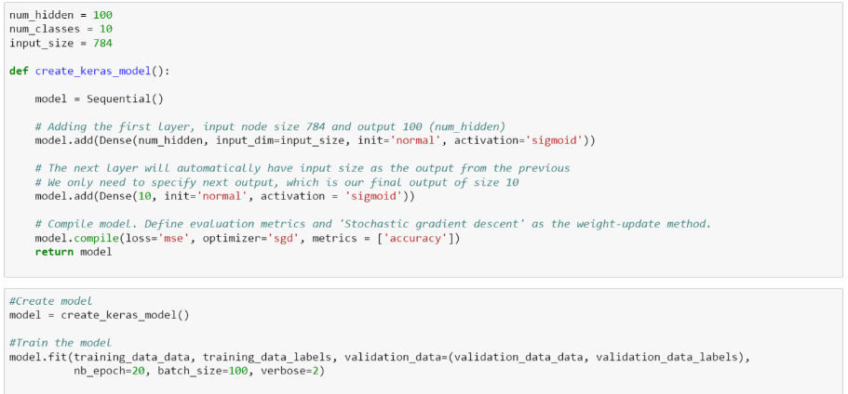
ML Case layout
https://github.com/annicai/codepub
We will implement parts of an ANN in order to understand better how it works
Load the data
Plot it, explore
Implement some missing parts of the ANN
Train the ANN.
Vary parameters, observe result
Which is the best model?
There are of course also good libraries for this.
With only a few lines of code one can train a ML model!
Example: Keras
All code needed to train an ANN with Keras

